Slide 1
Ddos attack on github

Slide 2
What is DDOS attack?
Distributed denial of service

Slide 3
DDoS attack on github
Attackers took advantage of caching system called as memcache D
Memcache is a distributed open source caching system then a lot of websites that use extensive database calls will implement because it allows information to be cached there and be presented to a user in a much quicker way.
They are distributed network of servers these servers has memory
If a user requests for a web application which will held is some kind of database inspite of directly requesting from database it will ask the Memcache d whether it has that copy of data which was requested.

Slide 4
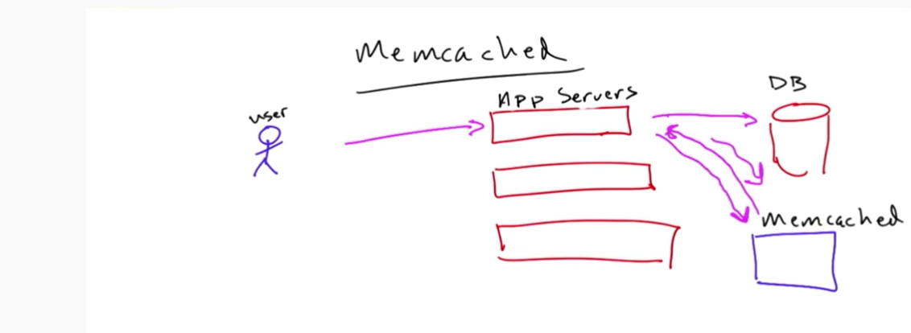
Memcache d
Built by the company called Danja to power a website called live journal.
2003
Facebook, reddif, youtube..

Slide 5




Attacker scans the internet to show any kind of public internet facing Memcache s
Get data
Src ip 1.2.3.4
ATTACKER
MemCache
Stream of Udp packets
1400 bytes of packets
GitHub
Database
Ipaddr 1.2.3.4

Slide 6
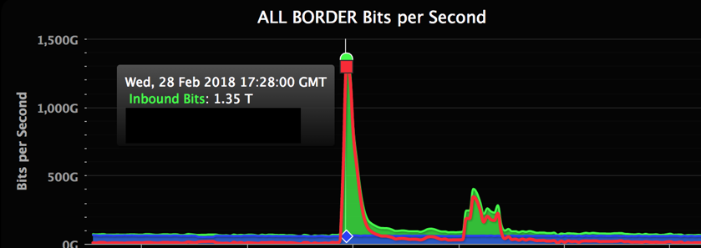

Slide 7
How github overcome this attack?
DDoS scrubbing centre.
When they noticed that they got a DDoS attack they rerouted all the traffic through DDoS scrubbing centre.
The DDoS Scrubbing Centre by nature take all of the data and drop the DDoS bad traffic and allow the legitimate traffic through the github.

Slide 8
Impact of the attack?
GitHub faced one of the largest attack ever recoded, which was ongoing for five days.
GitHub was non functional for 5 days.

Slide 9
Who was the mastermind?
China is widely suspected to be behind the recent attacks on Github .
Citizen Lab looked into these recent attacks and identified ‘Great Cannon’, a tool built to intercept data and redirect it to specific sites.
The Citizen Lab report surfaced evidence showing commonalities in Great Cannon. That’s another indicator that China was behind these malicious attacks

Slide 10

Thankyou

